Slide 1

CASE STUDY
This is one of the case study on customer data, product data and sales data where one of the analytics manager wants data analysts to find out different patterns and analysis by using Alteryx Designer Data Pipeline Reporting tool to implement and show derive insights by creating different data streamline by usage of in-built Alteryx tools from Tool Palette to help the company’s management to take data driven decisions for business growth.

Slide 2
PROBLEM STATEMENT:
Dataset gets generated everyday. Based upon the sales company data, every customer purchase products and customer profile gets created and stored in a database. Each customer being assigned an unique Customer_ID. Data maintained by Sales and Marketing team.
In Customer data, corresponding to each Customer_ID, we have customer names, Age, City, Country, Segment, Postal Code etc. Customer data, Product data Sales Data are given and need to find insights based upon individual dataset. Different formats of files are attached like XML, Text, Folder, JSON, SQL, ZIP, Tab delimited file.
In Product data, product details are maintained by product team in XML format. Each product has an unique Product ID.
Every time product being purchased by customer and sold, transaction being created and stored in a database. Most of the old transactional data are being dumped and stored in cloud storage service like Amazon S3. This is done for running database smoothly, efficiently and responsibly.
AGENDA:
Data has been given for end to end thorough analysis of data & an executive summary of your top findings, supported by graphs, plots, tables and trends by making a business report on specific sections like Products, Category, Age-Category, Segments and Regions. Execution of Alteryx Report and Data Pipeline need to be done along with Alteryx Workflow image in Alteryx Designer.
EXECUTIVE SUMMARY:
There are 793 Rows entries and 10 Columns variables found out for Customer data including various attributes , there are 1862 records and 4 columns found in Product Data and 9989 records and 30 columns in Sales data.

Slide 3
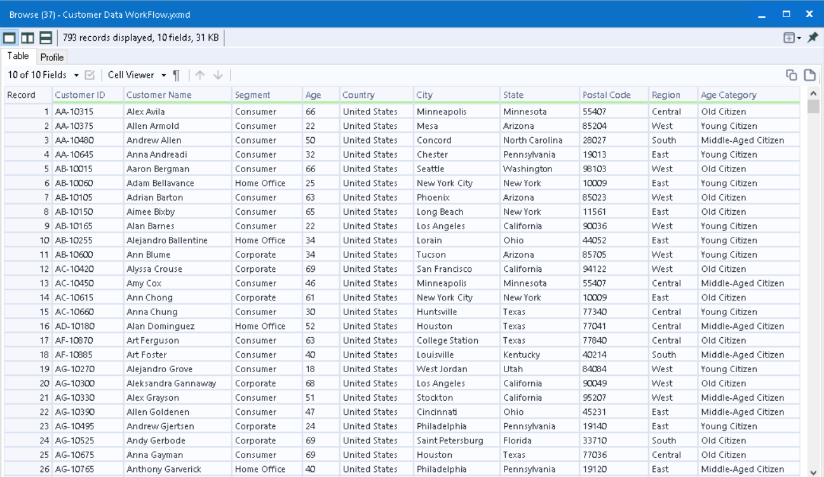
ALTERYX:
Alteryx is an ETL tool that clean the data, transform the data, blend the data and other advanced activities like predictive analytics, statistical analytics to create dynamic workflows, it helps business to make data driven decisions, automate essential tasks like Macro. Alteryx helps to connect from various data sources, data warehouses, flat files, cloud services.
In Customer data, we have 5 different extension files in csv file, excel file, manual entry data, tab delimited file, ZIP data file, Folder data file. All these different files have same kind of column names like Customer ID, Customer name, Segment, Age, Country, City, State, Postal Code and Region.
So in Alteryx designer, we used INPUT TOOL data to connect all individual data file and have used UNION tool to append the data to combine all the data vertically from different extension files. Later on one column Country has different text names of United States for which FIND & REPLACE tool has been used to name one unique text string United States. Then, DATA CLEANSING tool used to clean all blanks and errors ambiguities and signs symbols to get structured data. AUTO FIELD tool used to detect and assign data types to specified columns. MULTI FIELD BINNING tool implemented to categorize the data into 3 parts. FORMULA tool made to create conditional statement created for Age Category wise segregating 3 parts like Young Citizen, Middle Aged Citizen and Senior Citizen. Lastly customer data being saved by using OUTPUT TOOL in our local directory path.

Slide 4
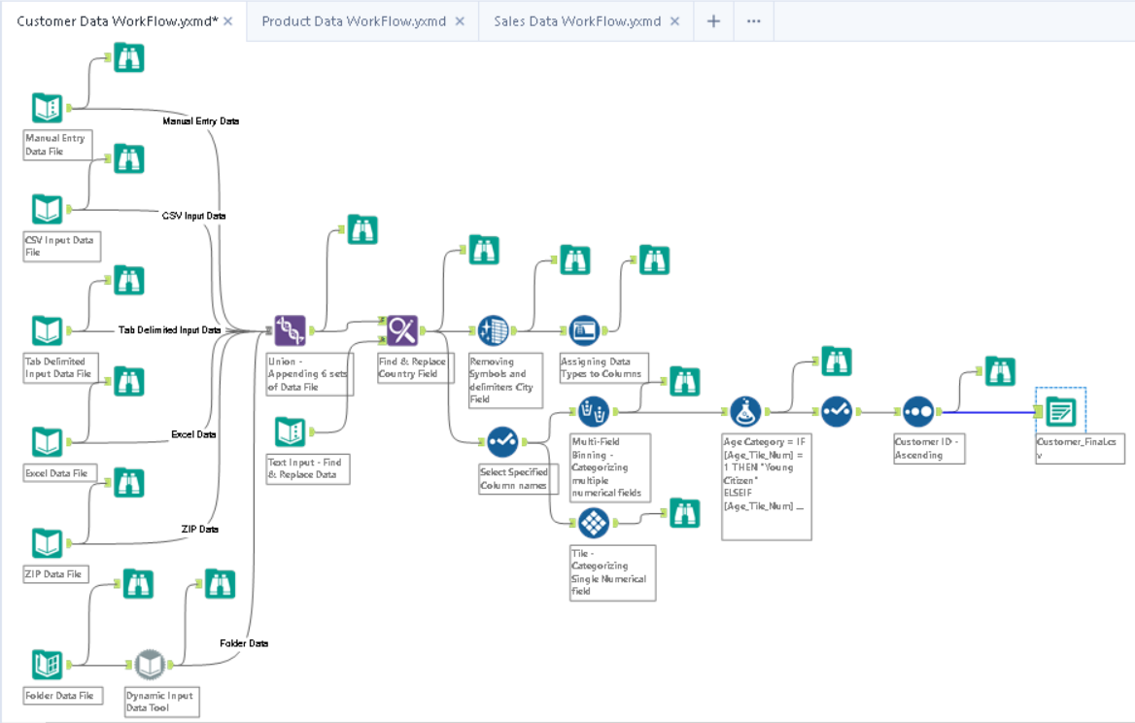
Customer Data Workflow

Slide 5
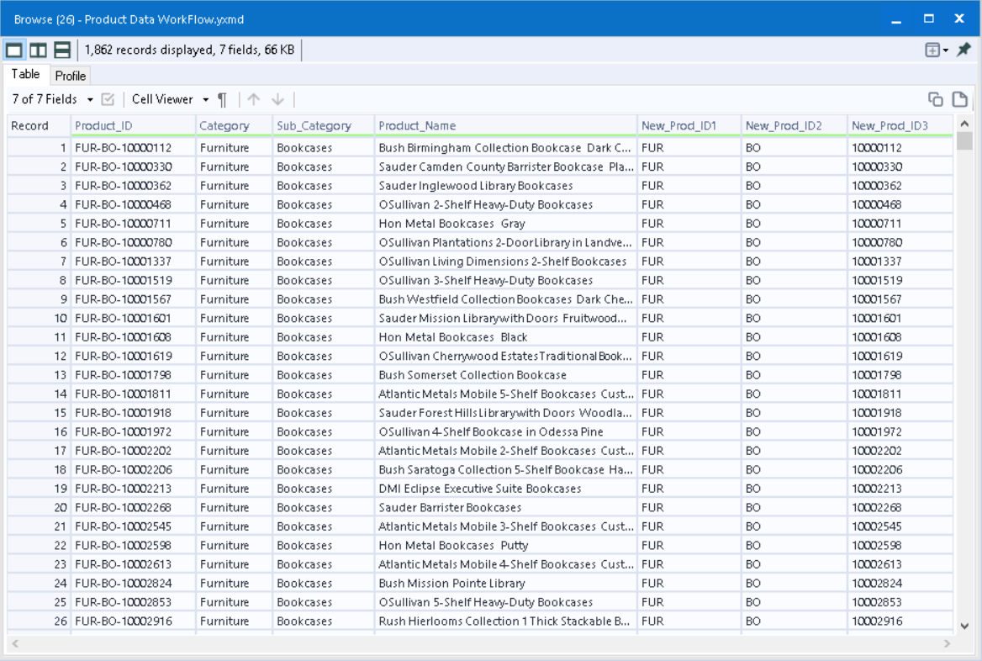
In Alteryx designer, we used INPUT TOOL data to connect Product XML data file and have used SELECT tool to check/uncheck the data to for getting preferred data. UNIQUE RECORDS being used to get unique records of data. TILE tool used to select ranges of rows SAMPLE tool used to showcase first last N rows and many other sections of sample types like percentage of N rows. RANDOM % SAMPLE tool used to implement sample number of records and % of records. SPLIT TO COLUMNS being used to split the column Product ID into 3 individual parts. Lastly product data being saved by using OUTPUT TOOL in our local directory path.

Slide 6
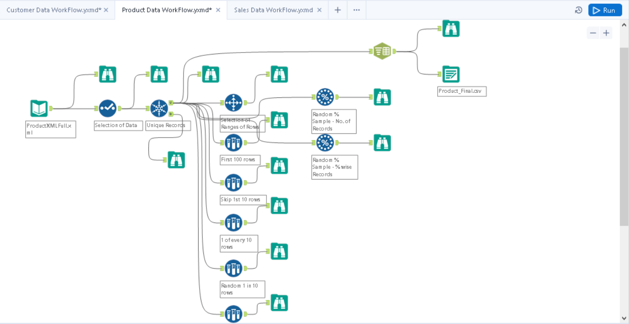
Product Data Workflow

Slide 7
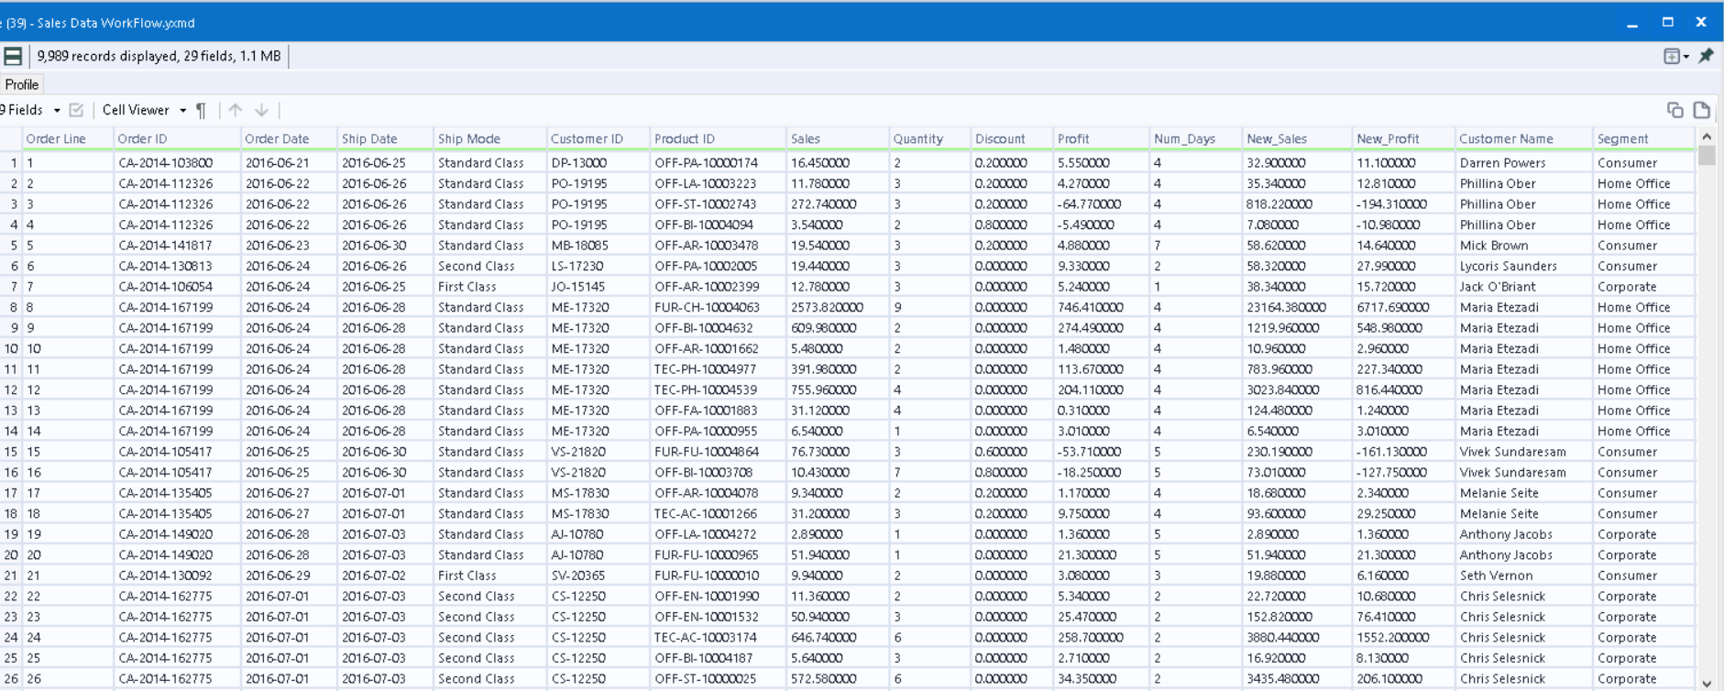
In Alteryx designer, we used INPUT TOOL data to connect PostgreSQL data file and AWS csv file and have used UNION tool to append the data vertically combining together for getting preferred data. DATE/TIME tool from PARSE tool palette being used to convert date format. FORMULA tool being used to see the difference of days between order date and ship date. MULTI FIELD FORMULA used to get new profit column by multiplying the numerical column names like Quantity and Profit. JOIN tool used to marge 2 different data like Sales and Customer data and later on with product data. SORT tool being used to sort and order the Order line column in ascending order. Based upon the business requirement SUMMARIZE tool used to get the derived result of Region wise Sales, Segment wise profit, Age Category wise Sales, Category Wise Profit. Segment wise NPV_Sales and Category wise NPV_Profit. COUNT ROWS tool used to get the total number of records for creating a business report. RUNNING TOTAL being used to get preferred cumulative result. CROSS TAB being used to get Age Category wise corresponding to category wise sales and Region corresponding to Segment wise Profit to create connectivity with BASIC TABLE tool for report. INTERACTIVE CHART being connected to all relevant SUMMARIZE tools being created. Lastly VISUAL LAYOUT tool being implemented to create and merge all related tables and charts plots to make derived report. RENDER tool used to get PDF file extracted from visual layout tool to showcase the derived insights.

Slide 8
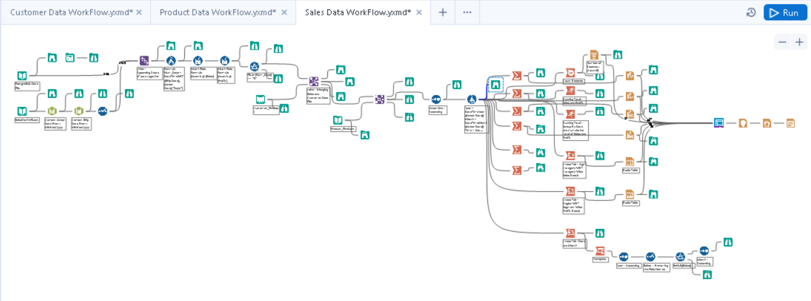
Sales Data Workflow

Slide 9
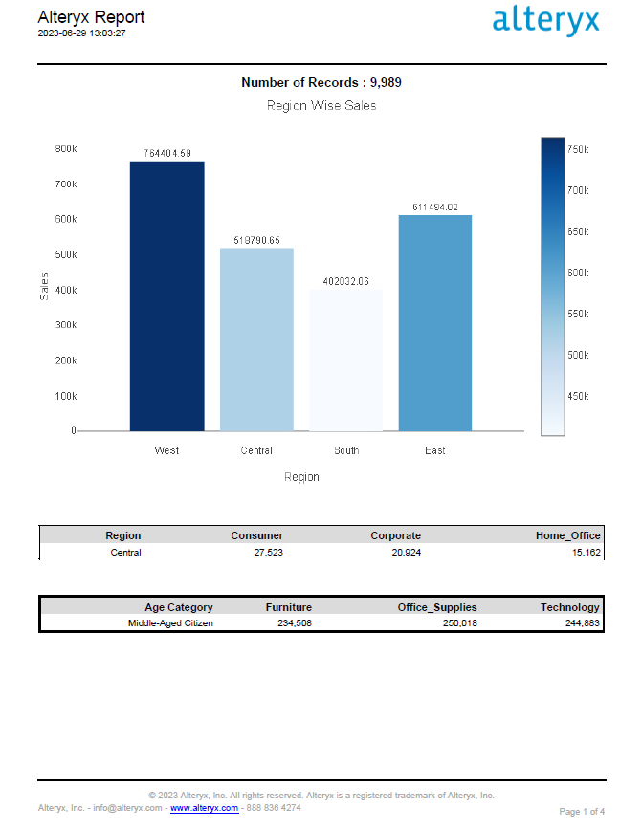
Case Study Business Report

Slide 10
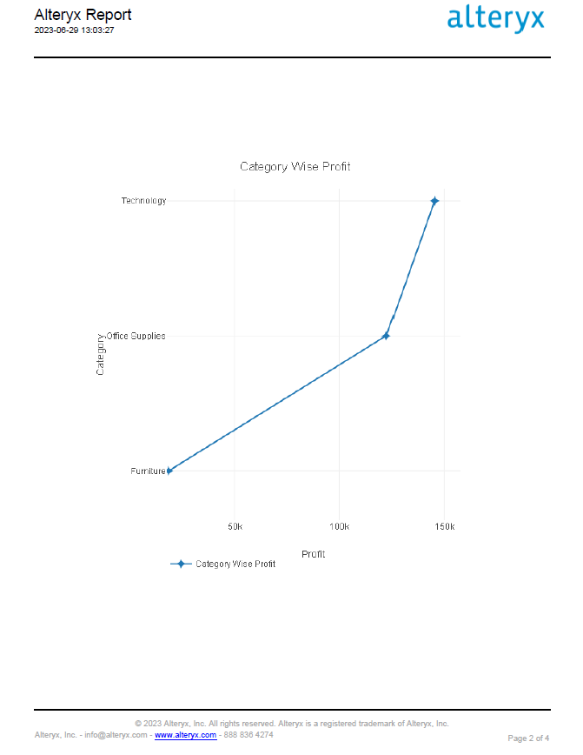

Slide 11
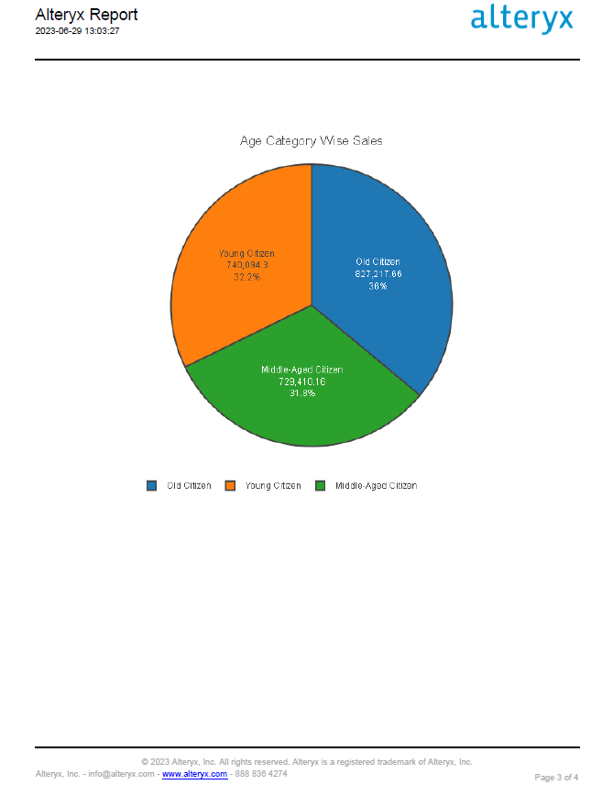

Slide 12
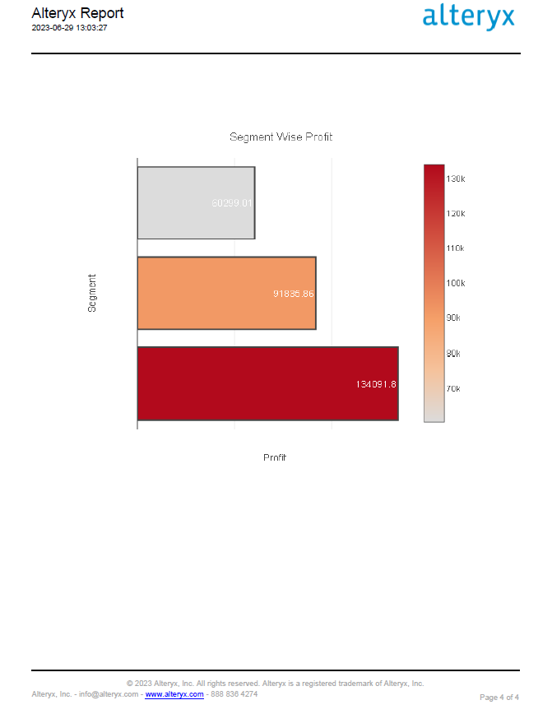

Slide 13
CASE STUDY COMPLETION
Created by:
RISHI KALPA MUKHERJEE

